Slide 1
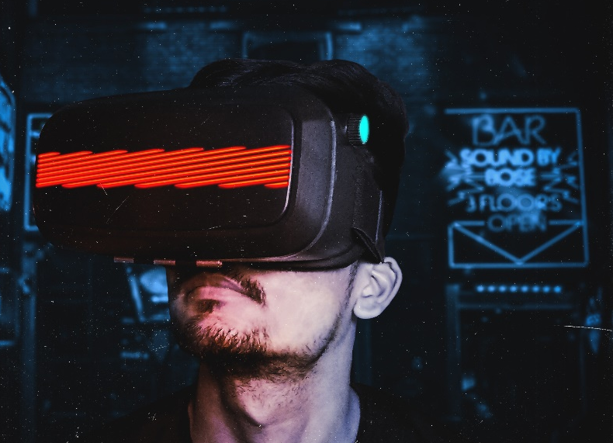
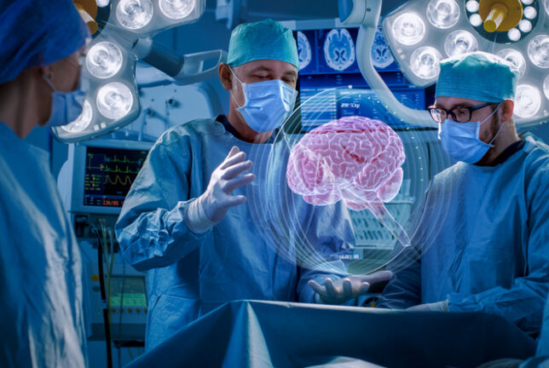
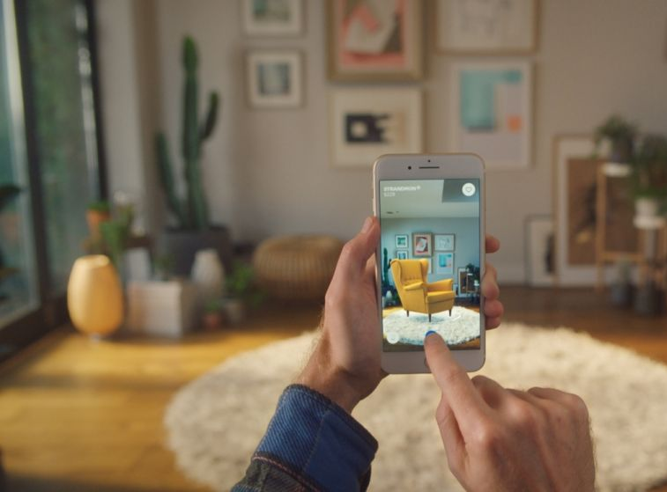
Erasmus Centre for Data Analytics
Expert Practice Immersive Technologies

Slide 2
Content
Immersive Technologies
Introduction
Our team
Overview of fields of Immersive Tech research
Current projects
Opportunities for collaboration
Workshops
Immersive Tech Space & Erasmus Behavioral VR Research Lab

Slide 3
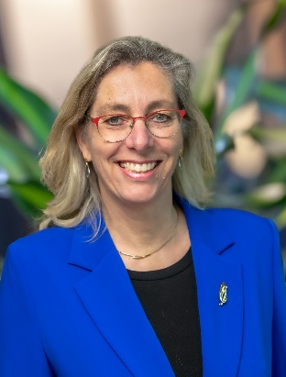
1. Immersive Technologies: Introduction
Immersive Technologies
Prof.dr. Yvonne van Everdingen
Academic Director
Expert Practice Immersive Technologies
Immersive technologies - Virtual Reality (VR), Augmented Reality (AR), and Mixed Reality (MR) - are increasingly used in a variety of disciplines, such as business, psychology, health care, and education. These leading technologies offer many promises but also entail several challenges to overcome.
In my inaugural address I have highlighted how immersive technologies can create value for companies, consumers, and society (see The Reality of a Virtual World). By leading this expert practice, I encourage researchers from different disciplines to help companies, consumers, and society creating this value.

Slide 4

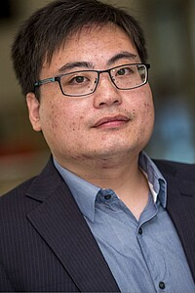
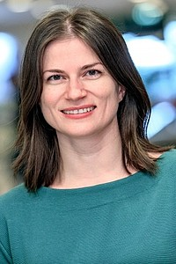
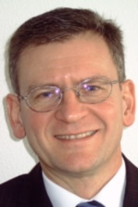
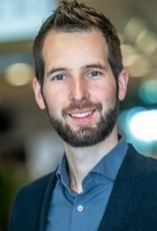
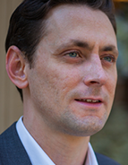
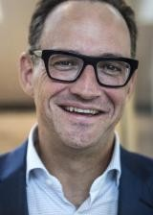




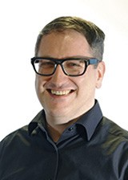
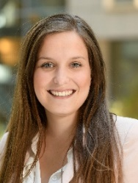



2. Our team (1): Meet the key experts
Immersive Technologies
“When the folks who understand the problems engage with the folks who understand what leading technology can do, innovation happens (Fink, Forbes 2017).”
Yvonne
van Everdingen
Xi
Chen
Ana Martinovici
René
de Koster
We are an international, interdisciplinary group of academics conducting research related to the use of VR, AR, and MR in business, psychology, health care, and education.
Our research aims to help companies, psychologists, health care specialists, and educators understand how to best use VR, AR, and MR to improve their performance.
Jelle
de Vries
Colin
Lee
Stefan
Stremersch
Ana
Scekic
Matthias
Wieser
Jackie
Poos
Vivian
Chen
Trilce
Navarrete

Slide 5
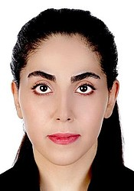
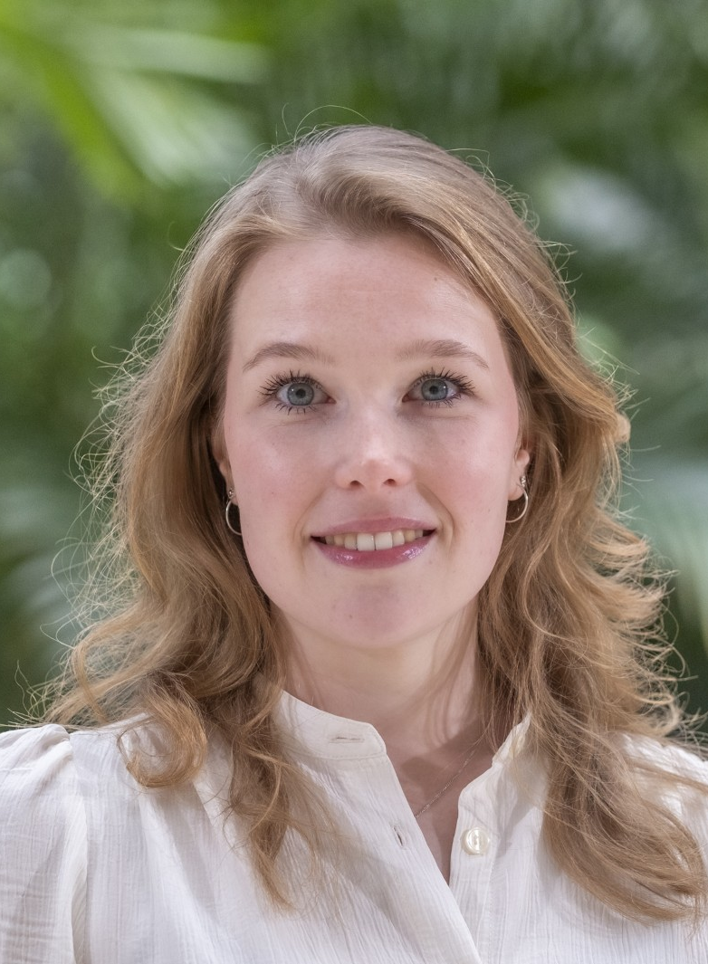
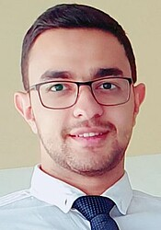
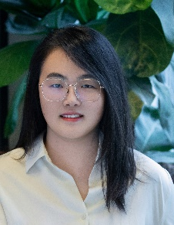
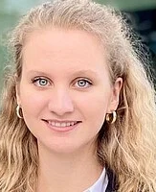
2. Our team (2): Meet the (affiliated) PhD researchers
Immersive Technologies
Mahsa Alirezaei, PhD candidate (RSM, EUR)
Started: September 2020
Topic: Human-Technology interaction in warehouse environments
Linde Assendelft, PhD candidate (Alzheimercentrum, Erasmus MC)
Started: July 2024
Topic: Neuropsychological assessment of social cognition in dementia
Danial Hayati, PhD candidate (RSM, EUR)
Started: September 2022
Topic: AR and Retailing
Sweeney Li, PhD candidate (ASCoR, UvA)
Started: February 2024
Topic: Greenwashing Influencer Marketing; Immersive Technologies in Promoting Prosocial Behavior
Julia Esters, PhD candidate (RSM, EUR)
Started: September 2024
Topic: VR and Retailing

Slide 6

2. Our team (3): Affiliated researchers
Immersive Technologies
Sha Yang
Professor of Marketing
USC Marshall School of Business
Research interests: search engine advertising, social networks, modeling consumer purchase behavior and market competition, Bayesian methods.

Slide 7
3. Overview of Fields of Immersive Tech Research
Immersive Technologies
The experts currently conduct immersive tech projects in Business, Mental Health Care, and Education, focusing on the following specific areas:
Business
Health Care
Training & Education
Retailing
Culture & Entertainment
Psychology
Training of (sales) managers
Marketing & Communication
Operations
Management
Neurology
Training of people in high- risk jobs

Slide 8
4. Projects in Business (1): Use of AR in Online Retailing
Immersive Technologies
Context: Online Retailing
Partners:
A Dutch online eyeglass retailer
A European AR software service provider
Objective:
Determining the effect of a virtual try-on with an AR application on product returns
Determining the boundary conditions when AR as virtual try-on option should be offered by online eyeglass retailers
Key researchers: Danial Hayati, Xi Chen, Yvonne van Everdingen

Slide 9

4. Projects in Business (2): Digital Street Art Depot
Immersive Technologies
Context: Culture & Entertainment
Partner: Street Art Museum Amsterdam (SAMA)
Funding: Cultuurloket DigitALL
Objective:
Keep street art alive for future generations
Developing a VR prototype of one existing piece of street art
Testing the consumer responses to this VR environment
Developing a viable business model for this VR prototype
Key researchers: Yvonne van Everdingen
Note: See the ECDA Expert Practice Digital Culture, Art, and AI for more information on other projects on arts and cultural institutions

Slide 10
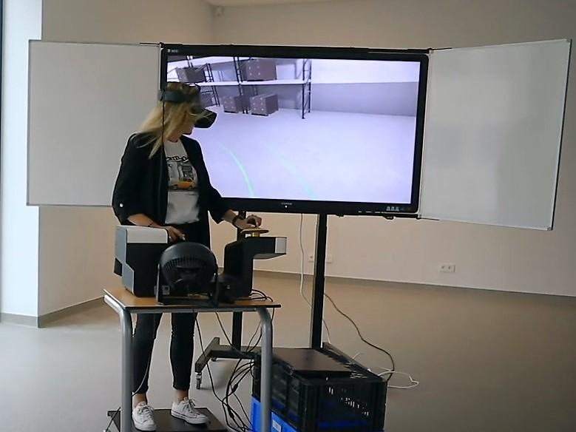
4. Projects in Business (3): VR & Warehouses
Immersive Technologies
Context: Operations Management
Partners: STC Group
Funding: Sharehouse Project (NWO Living Labs)
Objective:
Studying the effects of safety and productivity audio reminders on warehouse driver behavior by using VR
Key researchers: Mahsa Alirezaei, Jelle de Vries, Rene de Koster
https://onlinemagazine.logistiek.nl/smart-warehousing-2022-nr2/heftrucksimulatie
https://www.sharehouselab.nl/onderzoek-vr-experiment/

Slide 11

4. Projects in health care (1)
Context: Dementia diagnosis
Partners: Erasmus MC, Erasmus Universiteit, TU Delft
Funding: Alzheimer Nederland, Association for Frontotemporal Dementias, Erasmus MC
Objective: To develop a novel method for assessment of social cognition in dementia subtypes
Key researchers: Jackie Poos, Linde Assendelft, Yvonne van Everdingen

Slide 12
4. Projects in Education & Training
Immersive Technologies
Context: VR training for Police Officers
Partners: Dutch Police Organization / Tim Theeboom
Funding: Dutch Police Organization
Objective:
To test the effectiveness of VR training relative to traditional training formats
To develop an implementation plan for VR training at the Dutch police organization
Key researchers: PhD Candidate (Vacancy), Ting Li , Yvonne van Everdingen
See followowing link for more information on the PhD Vacancy
Ph.D. Research in Immersive Technology: Enhancing Police Training with VR

Slide 13



5. Opportunities for Collaboration
Immersive Technologies
Is your company interested in collaboration with experts from the Expert Practice Immersive Technologies?
Collaboration opportunities can take different shapes:
Data sharing and research collaboration
Research funding (e.g., PhD projects)
Contract research/consulting – 3 steps:
  1. Discovery: exploring opportunities for relevant VR and AR applications.
  2. Data collection and analysis: conducting interviews, experiments, etc. and analyze data to test the success potential of the different opportunities.
  3. Evaluation and feedback: evaluate the options and provide feedback and recommendations.

Slide 14
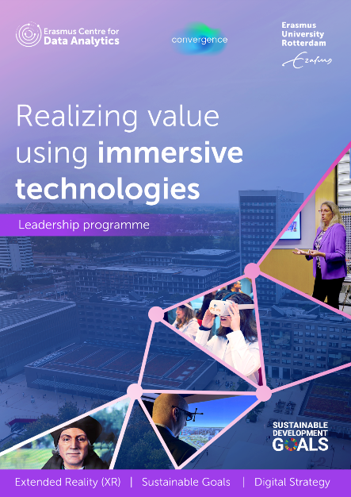
6. Workshops and Leadership Programs
Immersive Technologies
Does your company want to learn how to best use and implement Immersive Technologies in your company’s daily practices?
We can help you addressing your key challenges in workshops, which can take one of the following forms:
Small-scale workshop (e.g., one day), tailored to your specific needs
Leadership program (multiple days). See for more details the brochure

Slide 15
7. Immersive Technologies: Immersive Tech Research facilities
Immersive Technologies
Erasmus Behavioral Lab (EBL)
The EBL is a research lab for experimental research. The lab has great facilities for a mixture of research methods to study human behavior, such as EEG, Eye tracking, Virtual Reality, Augmented Reality. The great infrastructure supports academic researchers in conducting their research.
See for more information: https://www.eur.nl/essb/informatie-voor/onderzoekers/erasmus-behavioural-lab
Immersive Experience Lab
The Immersive and Experience Lab is supported by ECDA and located in the Polak building. It intends to:
connect campus stakeholders and external parties;
support education, as it is a space where students can experiment with immersive technologies;
support research, as the available technologies can be use for research projects.
See for more information: https://ecda.eur.nl/immersive-experience-lab/

Slide 16



Passion provides purpose, but data drives decisions
Prof.dr. Yvonne van Everdingen
yeverdingen@rsm.nl
www.eur.nl/data
https://www.linkedin.com/in/yvonne-van-everdingen-a0844028/

